Slide 1
Python programming
unit B4 – classification

Slide 2
classification
For classification problem, we have dataset of features, and also a target variable which is categorical.
Logistic regression is one of the ways for making binary (2 results) classification, using scikit-learn, which we have learnt before.
K-nearest neighbors is a typical classification algorithms.
Random forest can be used for classification (categorical) and regression

Slide 3
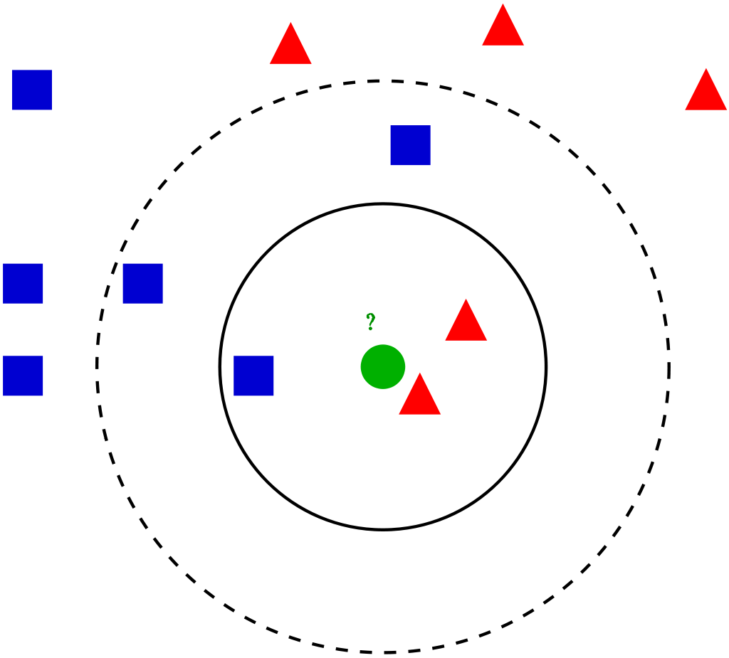
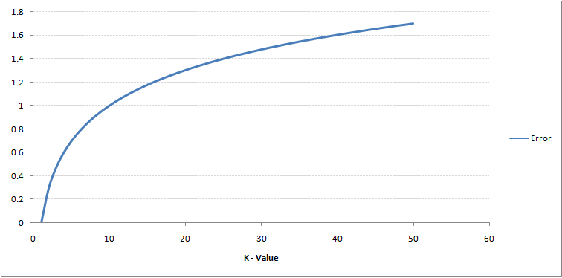
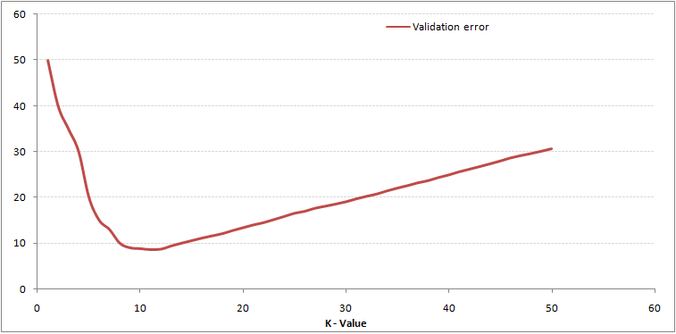
K-Nearest Neighbors
For the test data which need to do classification, find the nearest neighbors (k neighbors) from train data
Check how are those neighbors classified, then vote for the test data how it should be classified.
How to decide K, for all train data, the error rate is 0 when k = 1.
For test data, check how different k changes the error rate. Find the k with lowest error, then use this k for your future with the same kind of data.
training dataset
test dataset

Slide 4
Random forest
Random forest is a kind of ensemble algorithms. It depend on the decision tree algorithms.
Random forest randomly select from the training data and make some subsets, then make decision tree for each subset
For each test data to be predicted, use those decision trees to make the classification decision, and vote on the final classification result.

Slide 5
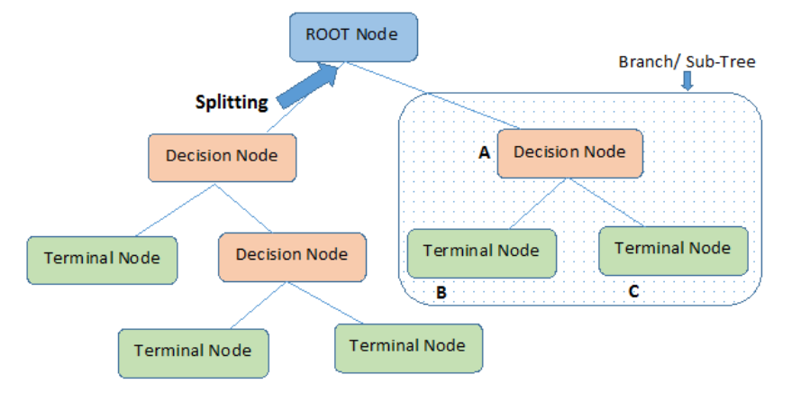
Decision tree
Root Nodes: It is the node present at the beginning of a decision tree from this node the population starts dividing according to various features.
Decision Nodes: the nodes we get after splitting the root nodes are called Decision Node
Leaf Nodes: the nodes where further splitting is not possible are called leaf nodes or terminal nodes
Sub-tree: just like a small portion of a graph is called sub-graph similarly a sub-section of this decision tree is called sub-tree.
Pruning: is nothing but cutting down some nodes to stop overfitting.

Slide 6
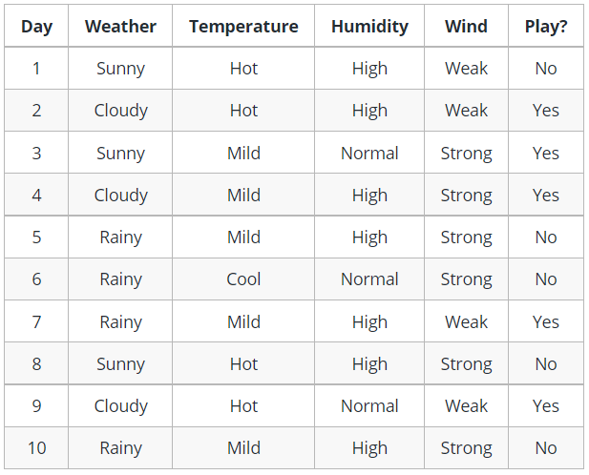
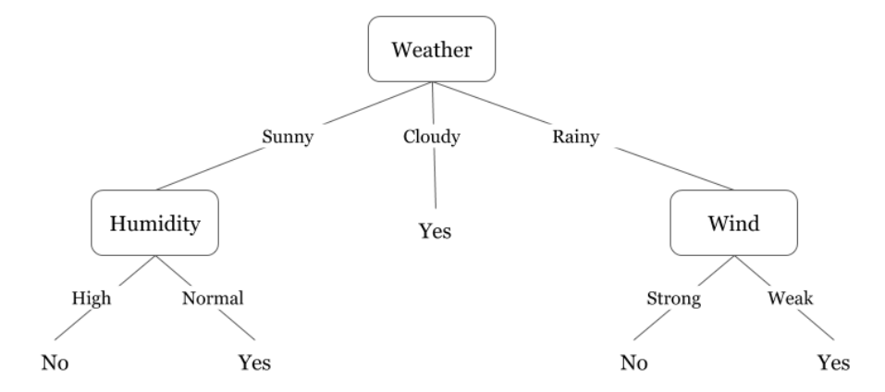
Decision tree sample

Slide 7


How to construct decision tree
The decision tree constructed using the feature values, and node is decided based on the criterion as follow:
Gini:
Entropy
$$GiniIndex=1−\sum_{j}{p_{j}^{2}}$$
$$Entropy=−\sum_{j}{(p_{j}{∙log}_{2}p_{j})}$$

Slide 8
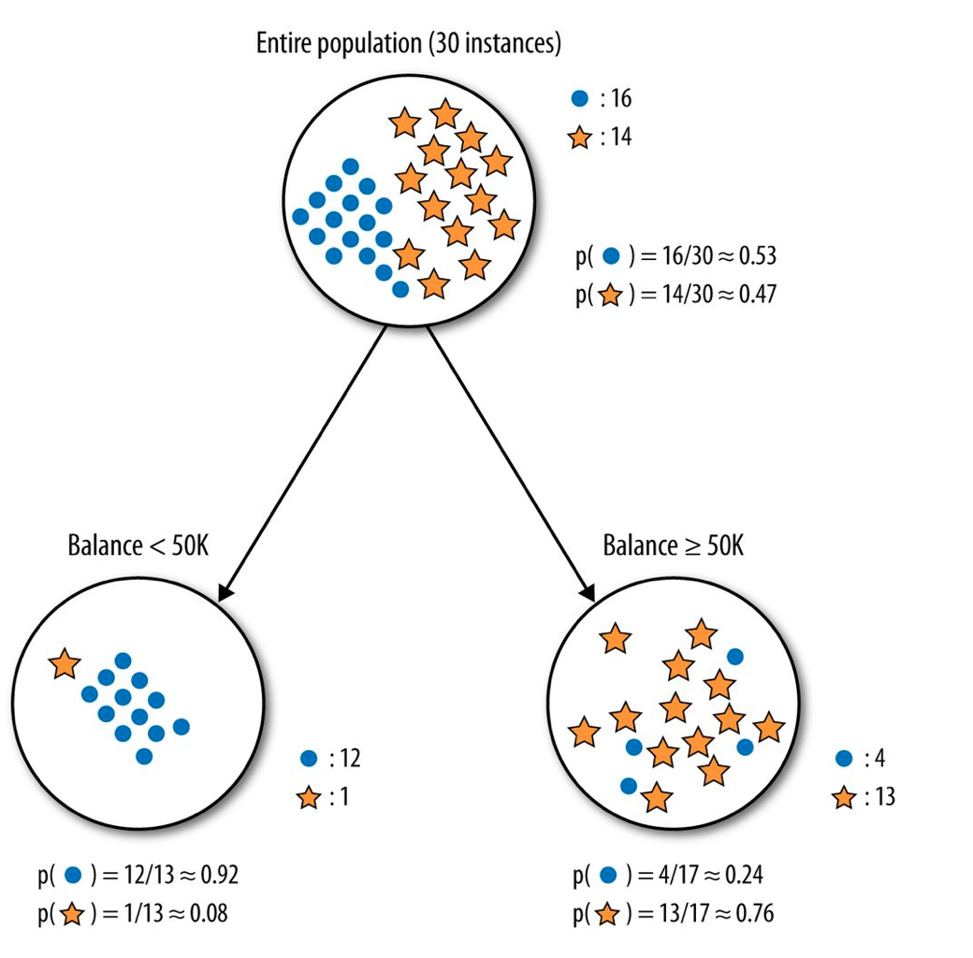
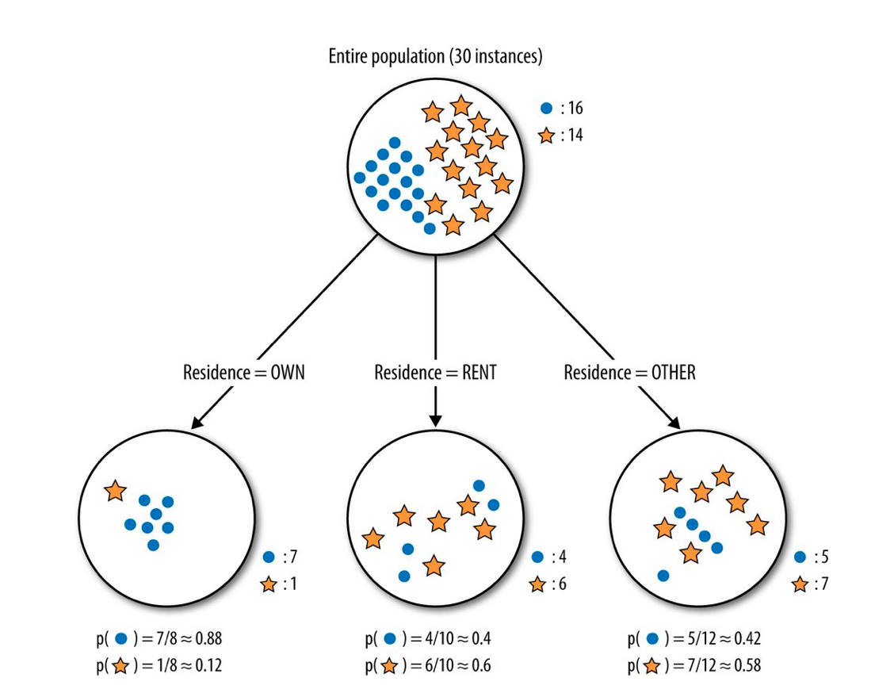


An entropy calculation example
https://towardsdatascience.com/entropy-how-decision-trees-make-decisions-2946b9c18c8
$E\left(parent\right)=−\frac{16}{30}\log_{2}(\frac{16}{30})$ $−\frac{14}{30}\log_{2}(\frac{14}{30})≈0.99$
$E\left(<50k\right)=−\frac{1}{13}\log_{2}(\frac{1}{13})$ $−\frac{12}{13}\log_{2}(\frac{12}{13})≈0.39$
$E\left(OWN\right)=−\frac{1}{8}\log_{2}(\frac{1}{8})$ $−\frac{7}{8}\log_{2}(\frac{7}{8})≈0.54$
$E\left(RENT\right)=−\frac{4}{10}\log_{2}(\frac{4}{10})$ $−\frac{6}{10}\log_{2}(\frac{6}{10})≈0.97$
$E\left(>50k\right)=−\frac{13}{17}\log_{2}(\frac{13}{17})$ $−\frac{4}{17}\log_{2}(\frac{4}{17})≈0.79$
$E\left(OTHER\right)=−\frac{5}{12}\log_{2}(\frac{5}{12})$ $−\frac{7}{12}\log_{2}(\frac{7}{12})≈0.98$
IG$=0.99−(\frac{13}{30}∗0.39$ $+\frac{17}{30}∗0.79)≈0.37$
IG$=0.99−(\frac{8}{30}∗0.54$ $+\frac{10}{30}∗0.97+\frac{12}{30}∗0.98)≈0.13$

Slide 9
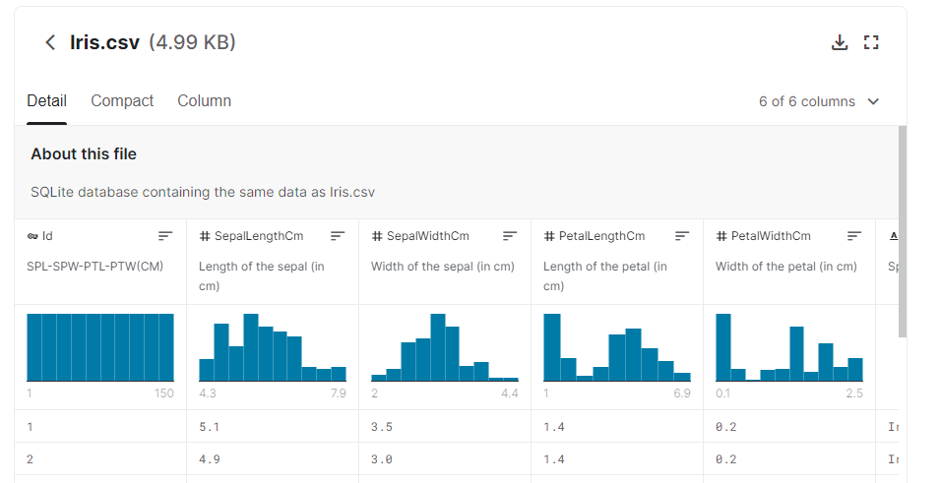
tasks
UCI machine learning data archive, wheat seeds data
https://archive.ics.uci.edu/ml/datasets/seeds
Iris dataset
https://www.kaggle.com/uciml/iris
Use the iris data set, try it using classification. You can try the classification method learned, or use the SVC

